Slide 1

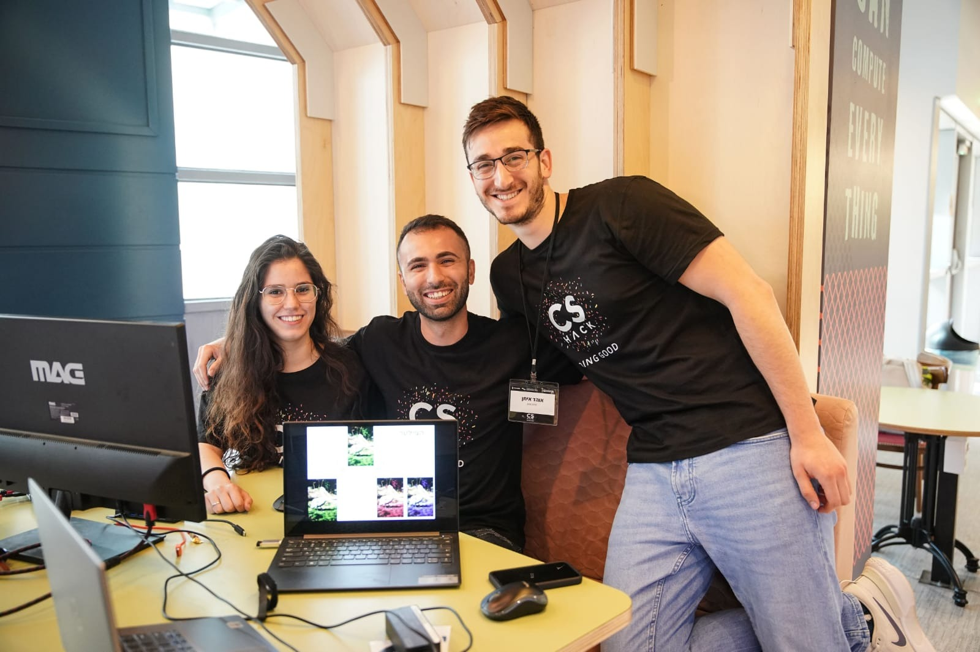
Colorful
Hackaton: A feature by Chaim Javaheri, Ohad Eitan & Shai Tayar
Summer project: Ohad Eitan

Slide 2
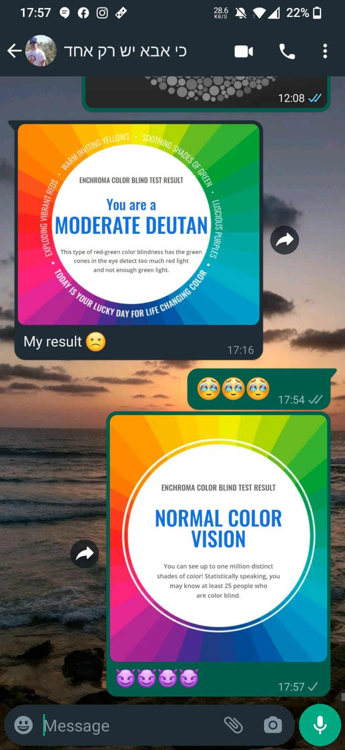
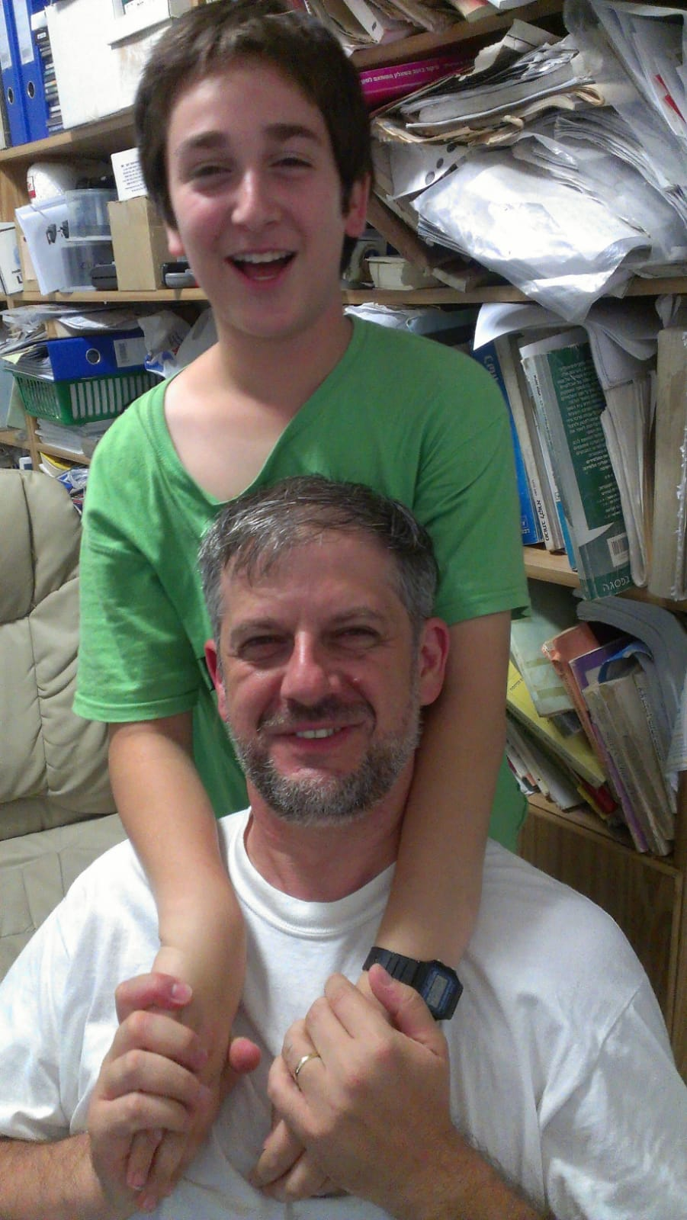

Motivation

Slide 3

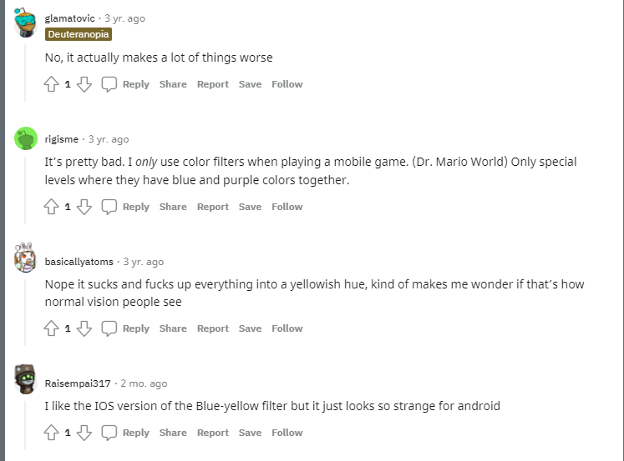
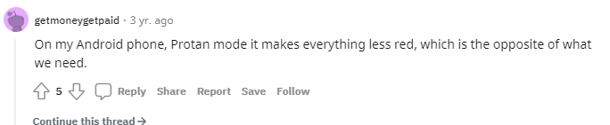
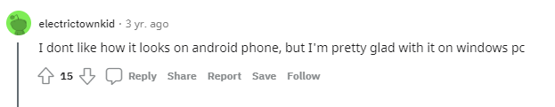
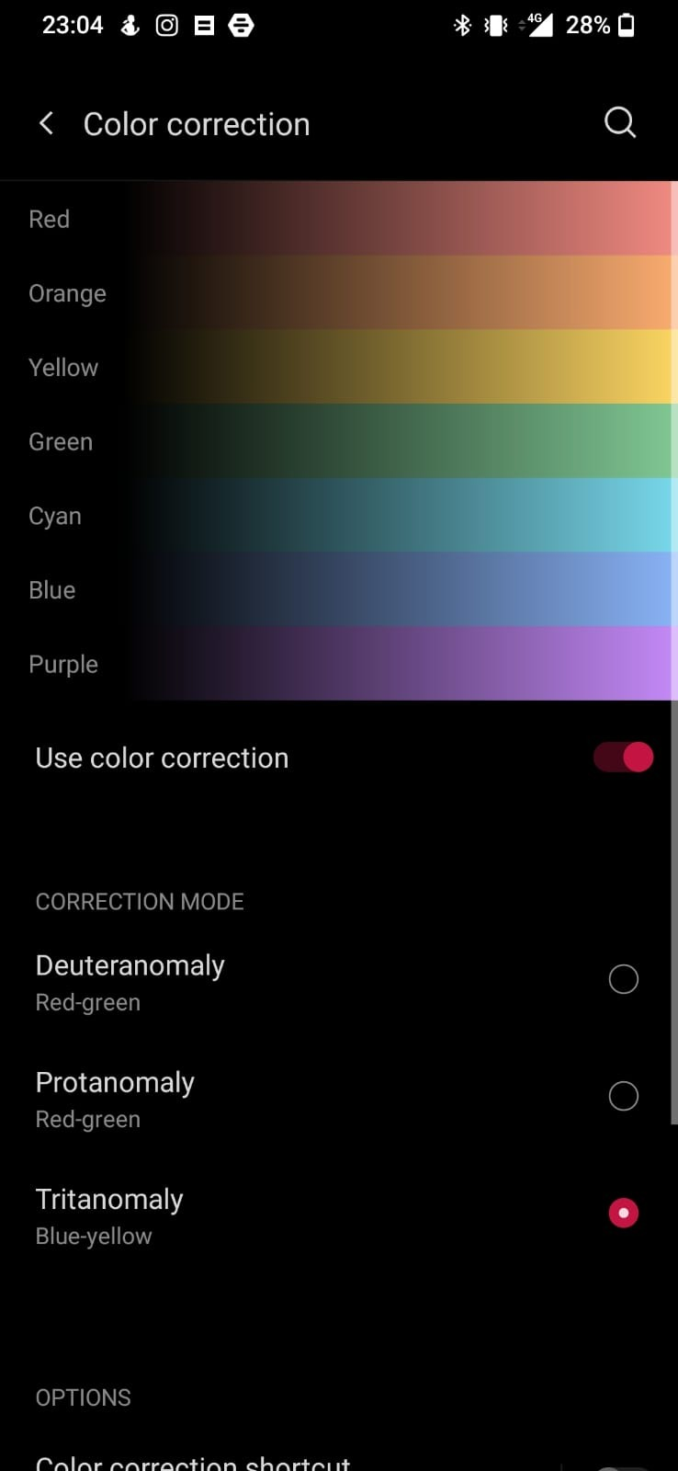
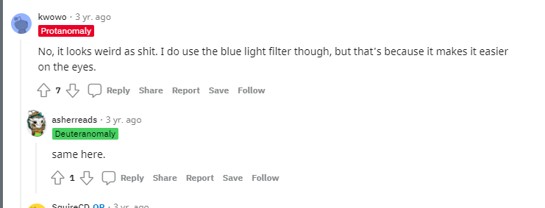
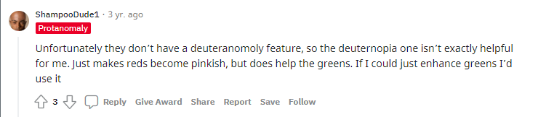

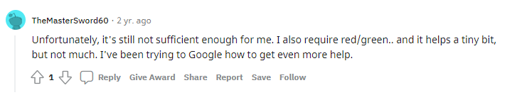
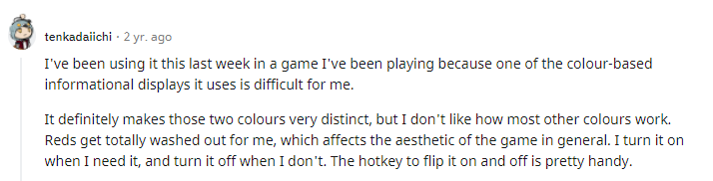
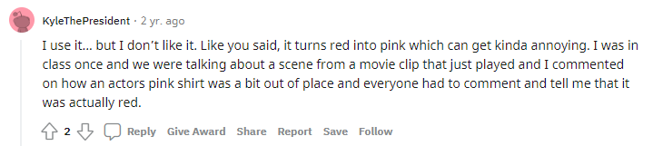
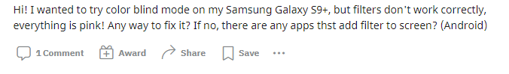
Many users claim default color filters in today’s devices aren't satisfying –
they lack personal customization
Notes:
https://www.reddit.com/r/ColorBlind/comments/cxczox/do_you_use_color_blind_mode_on_your_phone/
https://www.reddit.com/r/ColorBlind/comments/o4wmir/color_blind_mode_on_samsung/
https://www.reddit.com/r/ColorBlind/comments/bhgc6n/colorblind_mode_on_iphone/
https://www.reddit.com/r/ColorBlind/comments/ejhkg0/windows_10_colorblind_mode/
https://www.reddit.com/r/ColorBlind/comments/iqbm7n/just_discovered_colour_blind_mode_on_mac_im/

Slide 4
The Colorful Idea
A Personalized coloring filter for each color blind user
The feature will be integrated in the device’s system settings.
The feature will function as an addition to today’s devices default color filters.

Slide 5
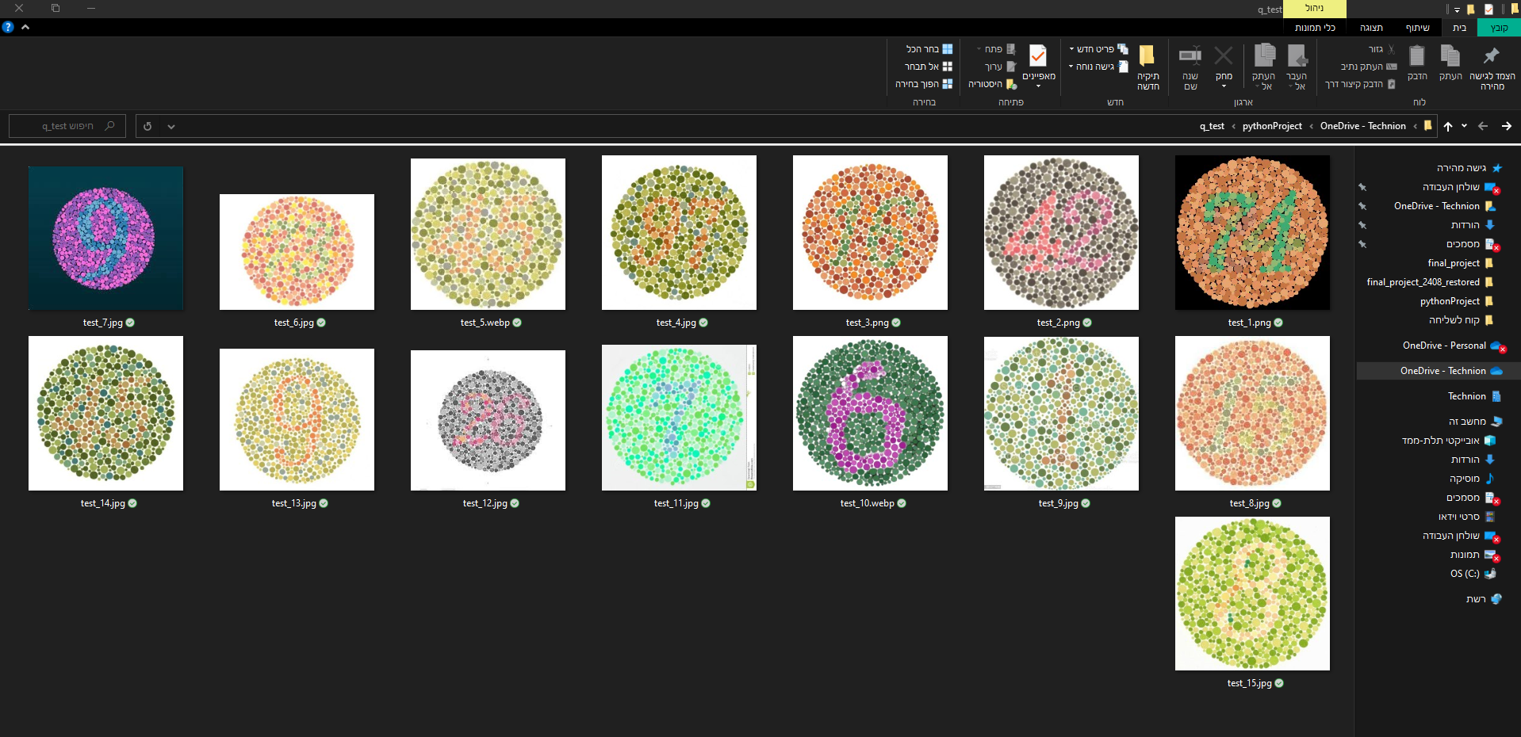
The Color-Blind Test

Slide 6
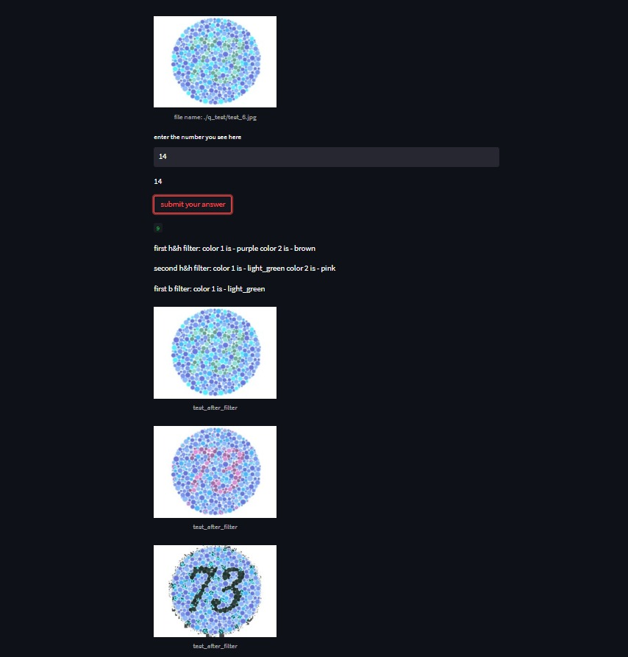
How Does It Works
Colorful is using: opencv, streamlitm and numpy

Slide 7
Let’s See Some Cool Filtered Pictures And Dive Into The Code

